Slide 1
Rust – Functions & Arrays
Week 7

Slide 2
Rust - Functions
Functions are the building blocks of readable, maintainable, and reusable code.
A function is a set of statements to perform a specific task. Functions organize the program into logical blocks of code.
Once defined, functions may be called to access code. This makes the code reusable.
Moreover, functions make it easy to read and maintain the program’s code.

Slide 3
Rust - Functions
A function declaration tells the compiler about a function's name, return type, and parameters. A function definition provides the actual body of the function.
S/No | Function & Description
1 | Defining a function A function definition specifies what and how a specific task would be done.
2 | Calling or invoking a Function A function must be called so as to execute it.
3 | Returning Functions Functions may also return value along with control, back to the caller.
4 | Parameterized Function Parameters are a mechanism to pass values to functions.

Slide 4
Defining a Function
A function definition specifies what and how a specific task would be done. Before using a function, it must be defined.
The function body contains code that should be executed by the function.
The rules for naming a function are similar to that of a variable.
Functions are defined using the fn keyword.
Syntax:
fn function_name(param1, param2... paramN)
{
// function body
}

Slide 5
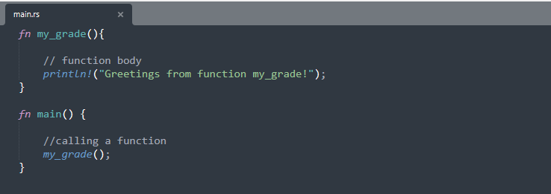
Invoking a Function
A function must be called so as to execute it. This process is termed as function invocation. Values for parameters should be passed when a function is invoked. The function that invokes another function is called the caller function.
Practice 1: week-6/practice_1/src/main.rs

Slide 6
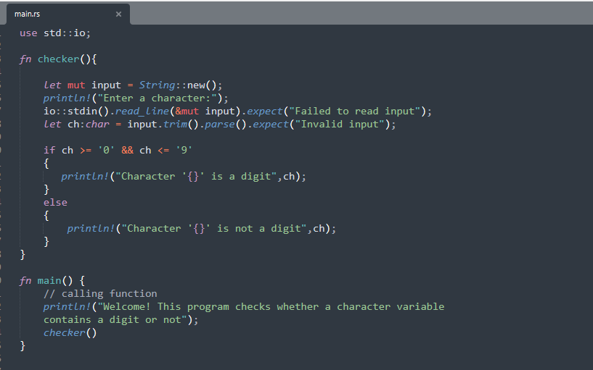
Invoking a Function
Practice 2: week-6/practice_2/src/main.rs

Slide 7
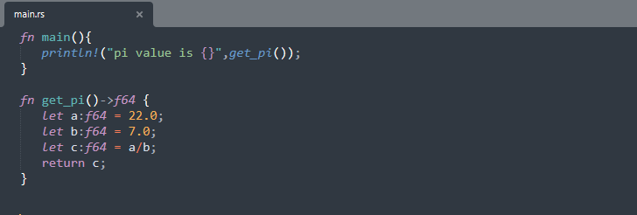
Returning Value from a Function
Functions may also return a value along with control, back to the caller. Such functions are called returning functions.
Syntax:
fn function_name() -> return_type {
//statements return value;
}
Practice 3: week-6/practice_3/src/main.rs

Slide 8
Function with Parameters
Parameters are a mechanism to pass values to functions.
Parameters form a part of the function’s signature. The parameter values are passed to the function during its invocation.
Unless explicitly specified, the number of values passed to a function must match the number of parameters defined.
Parameters can be passed to a function using:
Pass by Value
Pass by Reference

Slide 9
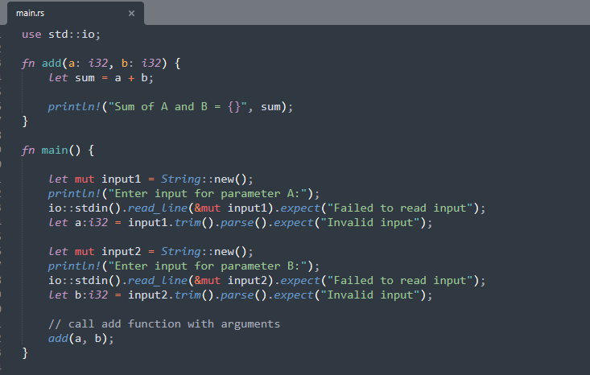
Function with Parameters
Practice 4: week-6/practice_4/src/main.rs

Slide 10
Pass by Value
When a method is invoked, a new storage location is created for each value parameter. The values of the actual parameters are copied into them. Hence, the changes made to the parameter inside the invoked method have no effect on the argument.
Practice_5 declares a variable num which is initially 5. The variable is passed as parameter (by value) to the mutate_num_to_zero()function, which changes the value to 0. After the function call, when control returns back to main method the value will be the same.

Slide 11
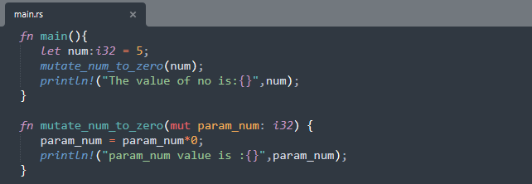
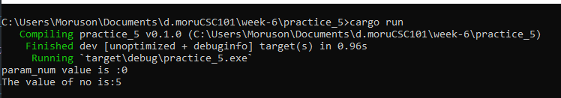
Pass by Value
Practice 5: week-6/practice_5/src/main.rs
Output:

Slide 12
Pass by Reference
When you pass parameters by reference, unlike value parameters, a new storage location is not created for these parameters. The reference parameters represent the same memory location as the actual parameters that are supplied to the method. Parameter values can be passed by reference by prefixing the variable name with an & .
In the Practice_6, we have a variable num, which is initially 5. A reference to the variable num is passed to the mutate_num_to_zero() function. The function operates on the original variable. After the function call, when control returns back to main method, the value of the original variable will be the zero.

Slide 13
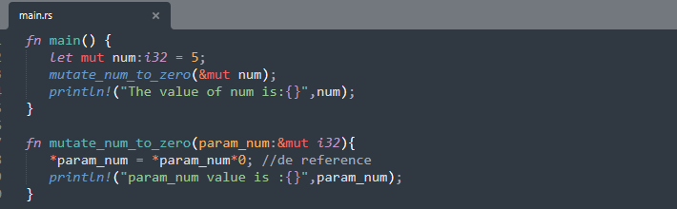
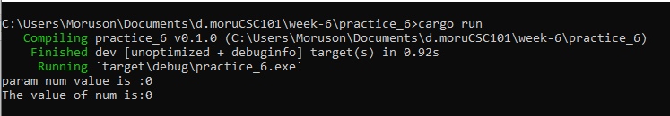
Pass by Reference
Practice 6: week-6/practice_6/src/main.rs
Output:

Slide 14
Rust - Arrays
An array is a homogeneous collection of values. Simply put, an array is a collection of values of the same data type.
Features of an Array
An array declaration allocates sequential memory blocks.
Arrays are static. This means that an array once initialized cannot be resized.
Each memory block represents an array element.
Array elements are identified by a unique integer called the subscript/ index of the element.
Populating the array elements is known as array initialization.
Array element values can be updated or modified but cannot be deleted.

Slide 15
Declaring & Initializing Arrays
The {:?} syntax of the println!() function is used to print all values in the array.
The len() function is used to compute the size of the array.
//Syntax1
let variable_name = [value1,value2,value3];
//Syntax2
let variable_name:[dataType;size] = [value1,value2,value3];
//Syntax3
let variable_name:[dataType;size] = [default_value_for_elements,size];

Slide 16
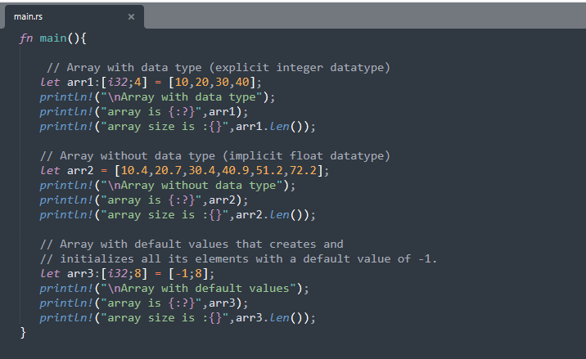
Declaring & Initializing Arrays
Practice 7: week-6/practice_7/src/main.rs

Slide 17
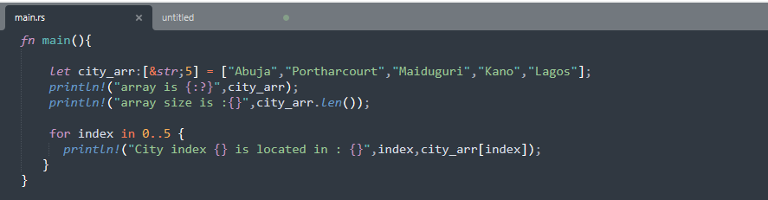
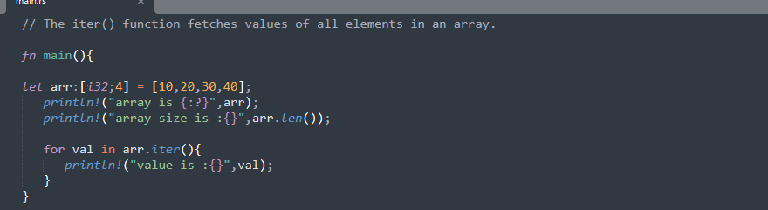
Array with For Loop
Practice 8: week-6/practice_8/src/main.rs
Practice 9: week-6/practice_8/src/main.rs ….(using iter() function)

Slide 18
Class Project

Slide 19
Project I
Your MTH 101 Professor has asked you to develop a Rust program that performs the following calculations:
Area of Trapezium formula = height/2*(base1+base2)
Area of the rhombus formula = ½ × diagonal1 × diagonal2
Area of Parallelogram formula = base x altitude
Area of Cube formula = 6 x (length of the side)²
Volume of Cylinder formula = π*radius² *height
Using your knowledge of Rust Functions, develop the program that prompts a user to select an equation, reads inputs and then performs the corresponding calculations.

